Slide 1
Sergiy Igorevich Palguyev
sergiy.palguyev@gatech.edu

Slide 2
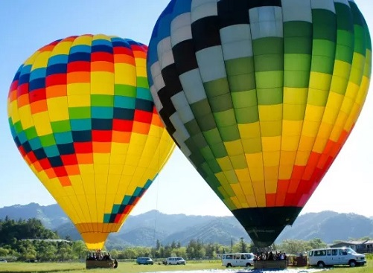
ps1-1-a-1.png

Slide 3
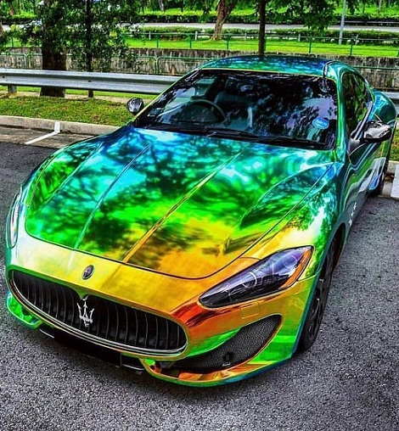
ps1-1-a-2.png

Slide 4
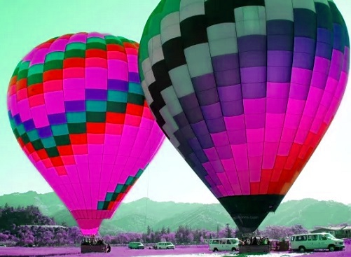
ps1-2-a-1.png

Slide 5
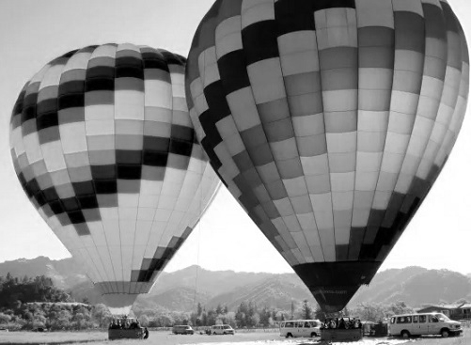
ps1-2-b-1.png

Slide 6
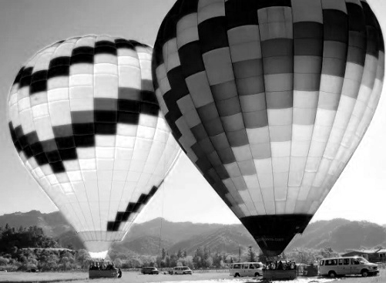
ps1-2-c-1.png

Slide 7
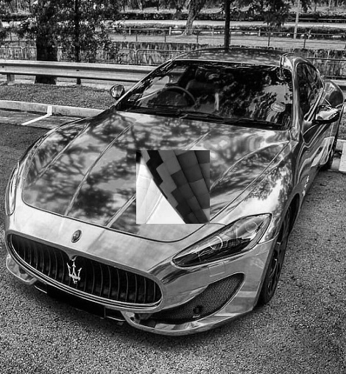
ps1-3-a-1.png

Slide 8
imageStats(img1_green)
('The min pixel value of img1_green is', 0)
('The max pixel value of img1_green is', 255)
('The mean pixel value of img1_green is', 136.10581561672296)
('The std dev of img1_green is', 69.154639871216688)

Slide 9

ps1-4-b-1.png

Slide 10

ps1-4-c-1.png

Slide 11
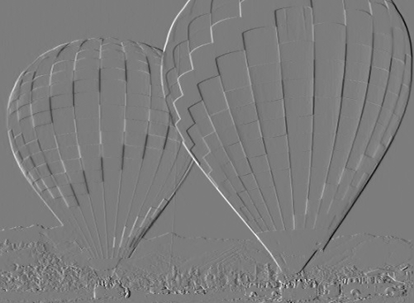
ps1-4-d-1.png

Slide 12

ps1-5-a-1.png

Slide 13

ps1-5-b-1.png

Slide 14
Discussion
A)The Green channel is closest to GrayScale, irrelevant to the picture used. This is due to the fact that in a Bayer (image sensor) there are about 2x more green sensitive areas than red or blue. Additionally, CMOS sensors are more sensitive to the green and red channels, than the blue channel. Also, our eyes are about 50% as sensitive to red as to green, and about 20% as sensitive to blue.
B)Storing negative values mean maintaining the information (magnitude) of the negative values – without clipping. This can be done by using an abs() function to change the negative values to positive.
C) The blue channel looks better than the green channel. Sigma = 15. Since the green channel is most pronounced, any noise in the green channel will be more pronounced also.

